Slide 1

PREDICTING PEDIATRIC APPENDICITIS BASED ON THE CLINICAL DATA

Slide 2
TABLE OF CONTENTS
PROBLEM STATEMENT
INTRODUCTION
ABOUT THE DATASET
DATA PREPROCESSING
EXPLORATORY DATA ANALYSIS
MODEL BUILDING
MODEL COMPARISON
CONCLUSION

Slide 3
PROBLEM STATEMENT
Determining the significant factors and building a model that prioritizes patients by flagging them for appendicitis based on preliminary clinical symptoms to provide the emergency care.

Slide 4

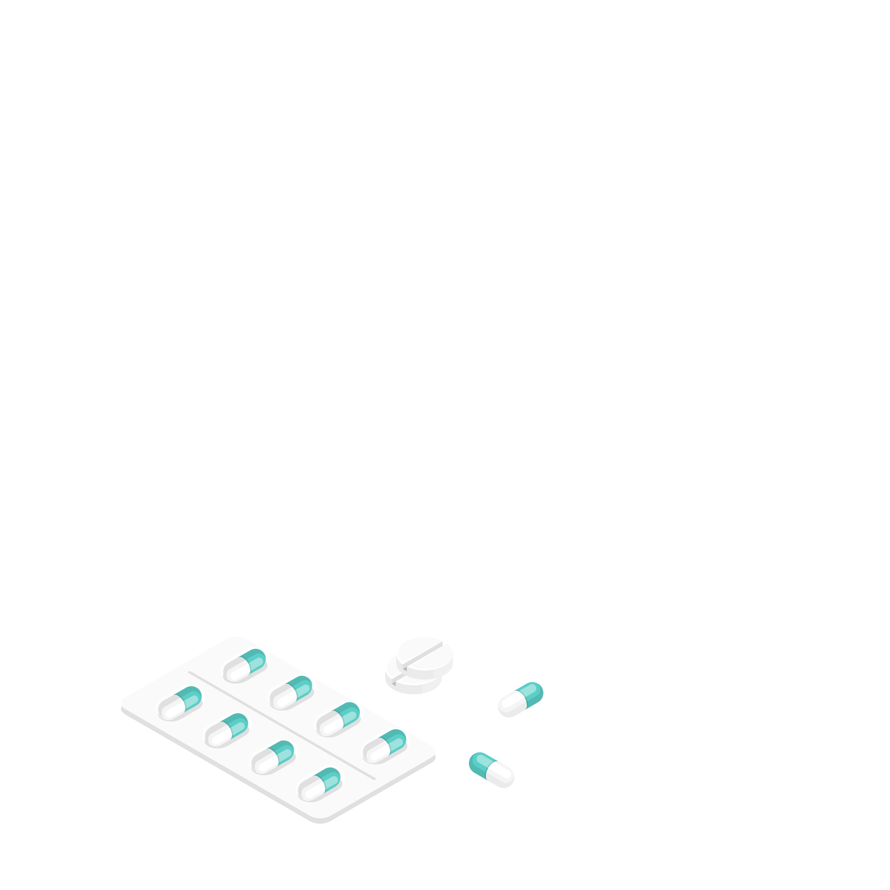
INTRODUCTION
Pediatric Appendicitis
Inflammation in the appendix
The most common surgical emergencies in pediatric patients.
Abdominal pain (particularly in the lower right quadrant), nausea, vomiting, and fever.
Early diagnosis and appropriate treatment generally lead to favorable outcomes.

Slide 5
ABOUT THE DATASET
Collected from pediatric patients admitted with abdominal pain at Children’s Hospital St. Hedwig in Regensburg, Germany.
Time period : 2016 to 2021.
782 Instances
Patients up to age 18.

Slide 6








SELECTING CLINICAL FEATURES
AGE
GENDER
MIGRATORY PAIN
ANOREXIA
LOWER RIGHT ABDOMINAL PAIN
COUGHING PAIN
BODY TEMPERATURE
NAUSEA

Slide 7
DATA PREPROCESSING
MISSING VALUES IN THE DATASET
2
6
NUMERICAL COLUMNS
CATEGORICAL COLUMNS
Mean Imputation
Mode Imputation

Slide 8
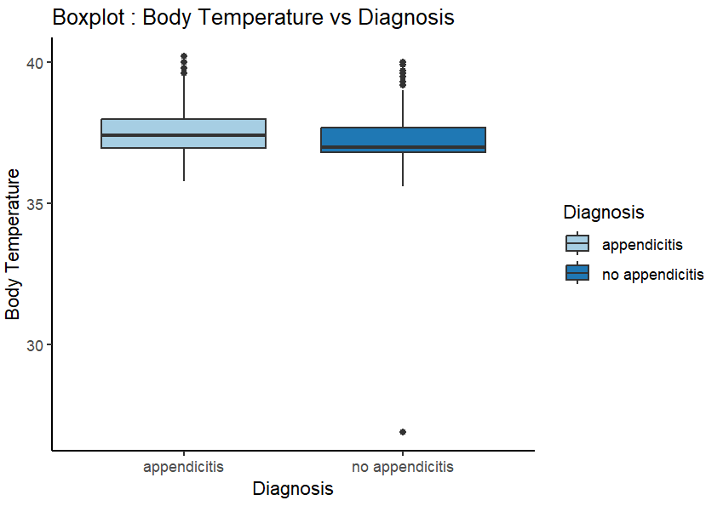
HANDLING OUTLIERS

Slide 9
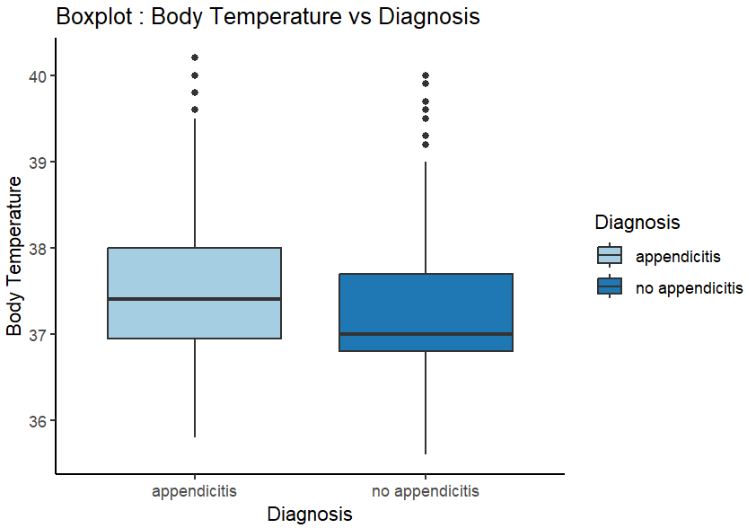
HANDLING OUTLIERS

Slide 10
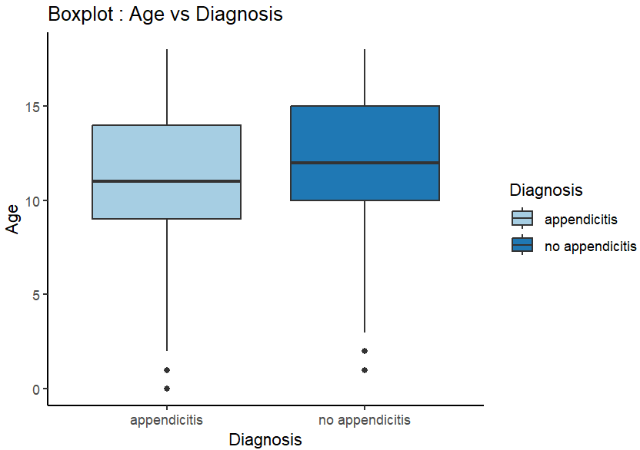
HANDLING OUTLIERS

Slide 11
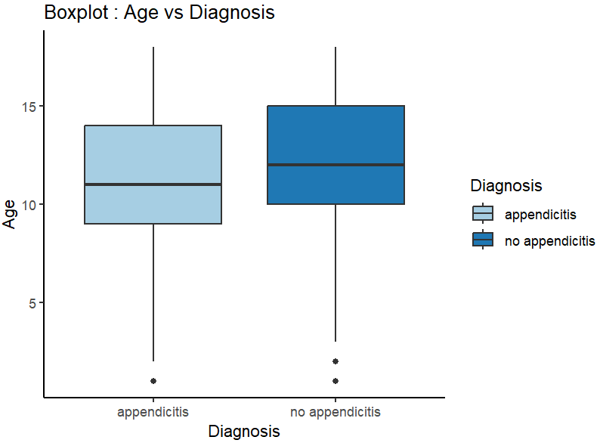
HANDLING OUTLIERS

Slide 12
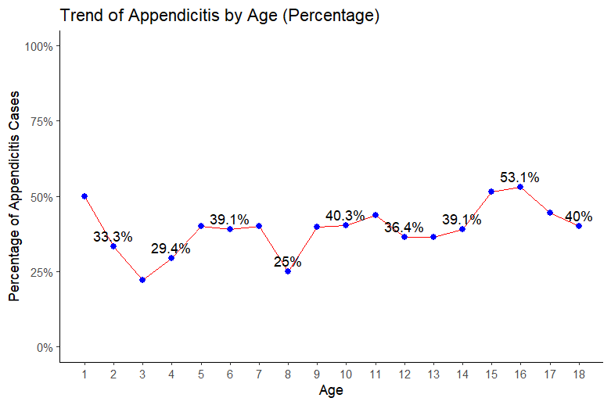
EXPLORATORY DATA ANALYSIS

Slide 13
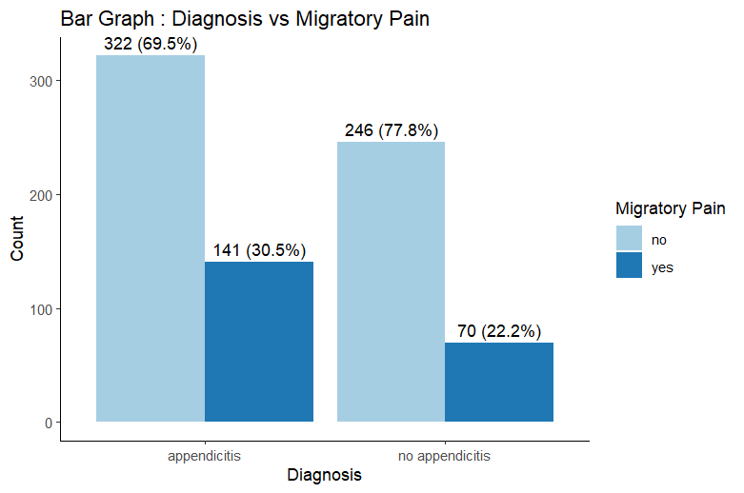
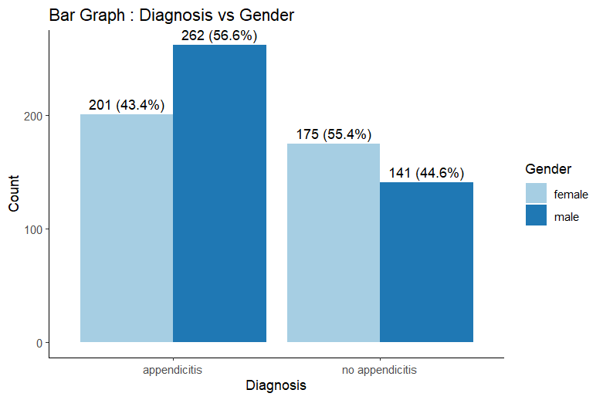
EXPLORATORY DATA ANALYSIS

Slide 14
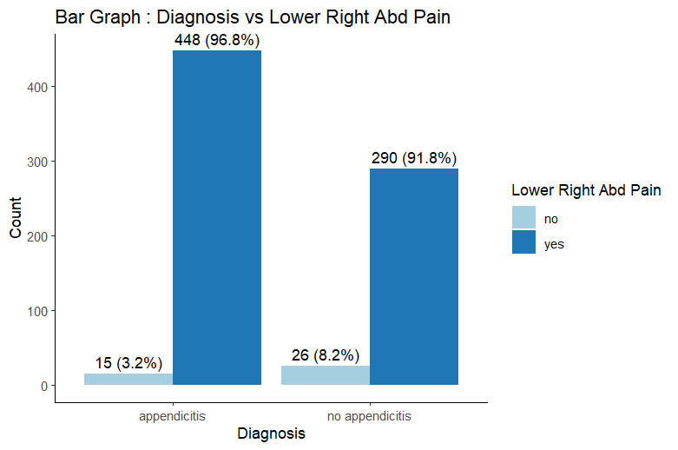
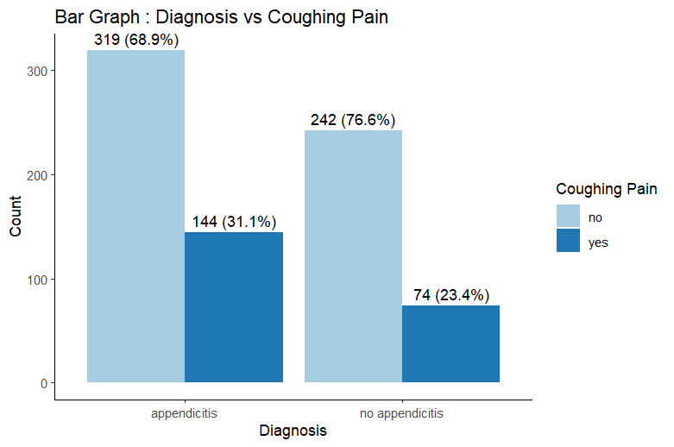
EXPLORATORY DATA ANALYSIS

Slide 15
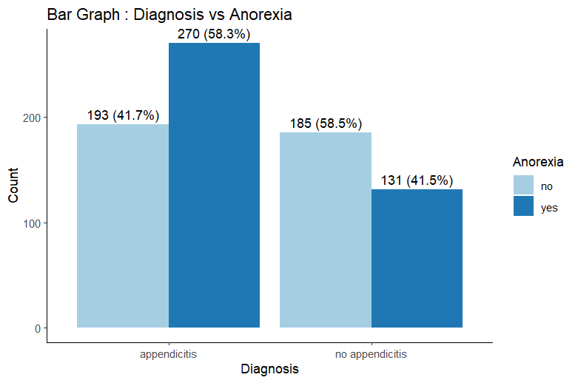
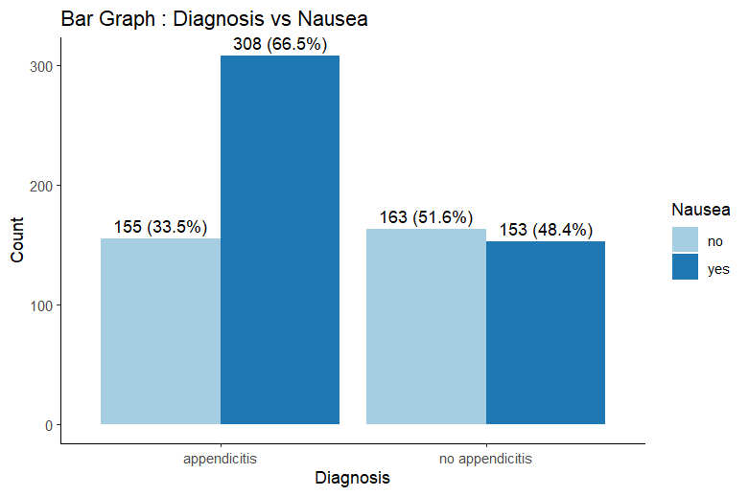
EXPLORATORY DATA ANALYSIS

Slide 16
MODEL BUILDING
Full Model : Includes all the features
Simple Model : Just the significant features
Interaction Model 1 : Includes all the features and Interaction terms
Interaction Model 2 : Just the significant interactions

Slide 17
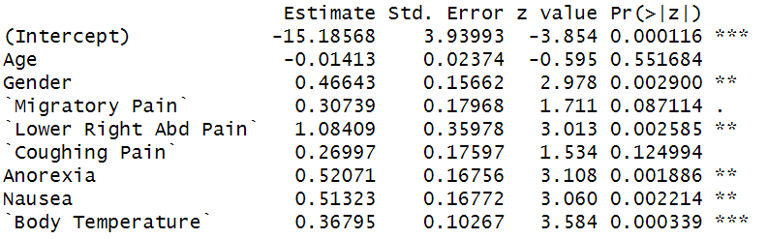
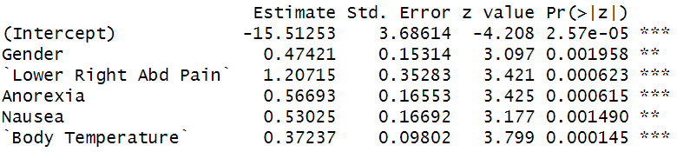
MODEL BUILDING
FULL MODEL
SIMPLE MODEL

Slide 18
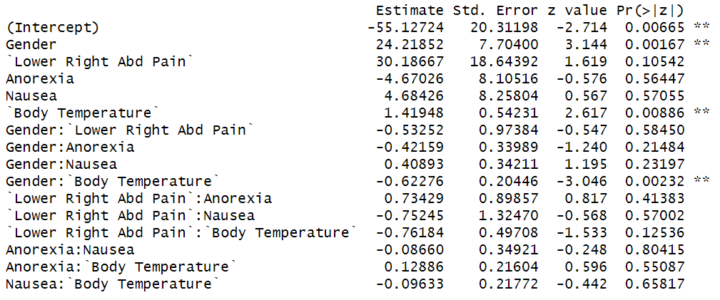
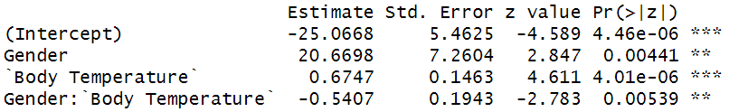
MODEL BUILDING
INTERACTION MODEL 1
INTERACTION MODEL 2

Slide 19
Model Comparison
H0: Simpler Model fits better.
Ha: Complex Model fits better.
Simpler Model | Complex Model | P-Value
Simple Model | Full Model | 0.12
Simple Model | Interaction Model 1 | 0.09
Interaction Model 2 | Simple Model | ≈0.00
P-Value < 0.05 = Reject H0 = Complex Model fits better.
P-Value > 0.05 = Do Not Reject H0 = Simpler Model fits better.

Slide 20
AIC and BIC
Model | AIC | BIC
Full Model | 992.0260 | 1033.948
Simple Model | 991.8920 | 1019.840
Interaction Model 1 | 995.4828 | 1070.011
Interaction Model 2 | 1024.1642 | 1042.796
The model with low AIC and BIC is the better model.

Slide 21
Interpreting Coefficients
Variable | Coefficient | Effect
Gender(Male) | 0.47421 | Increases the chances by 61%
Lower Right Abdominal Pain | 1.20715 | Increases the chances by 234%
Anorexia | 0.56693 | Increases the chances by 76%
Nausea | 0.53025 | Increases the chances by 70%
Body Temperature | 0.37237 | Increases the chances by 45% / Unit

Slide 22
Conclusion
Simple Model with just the significant features without interaction terms is a better model.
Significant features : Gender, Lower Right Abdominal Pain , Anorexia, Nausea , Body Temperature.

